Slide 1
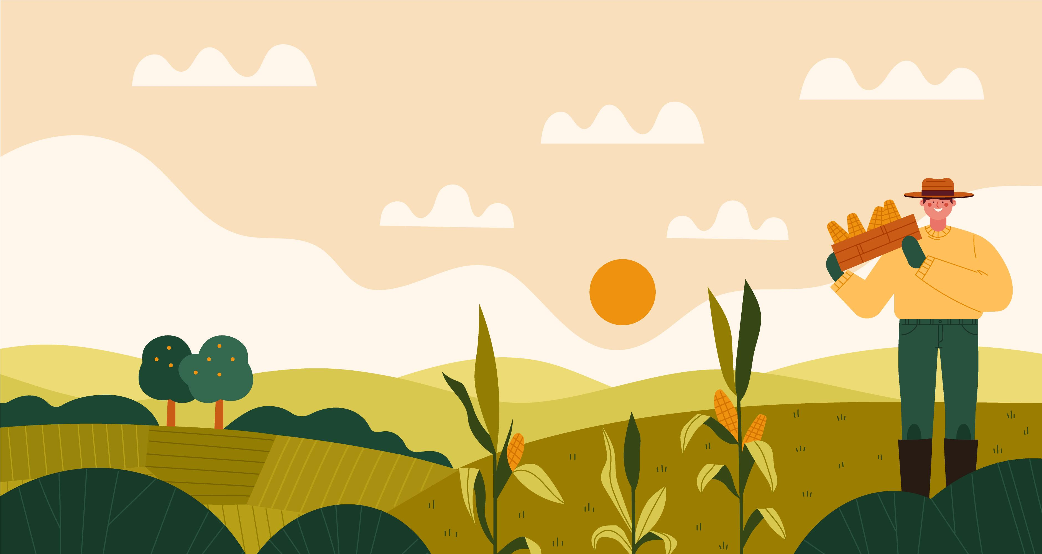


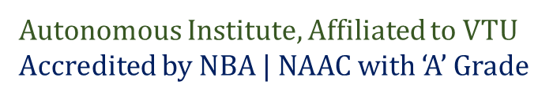
< INFOTON 2.0>
Team: ‘Sensorial Troupe’
Presenting on:
INTELLIFARM-SENSE HUB
A smart irrigation project based on the
domain of IOT.

Slide 2
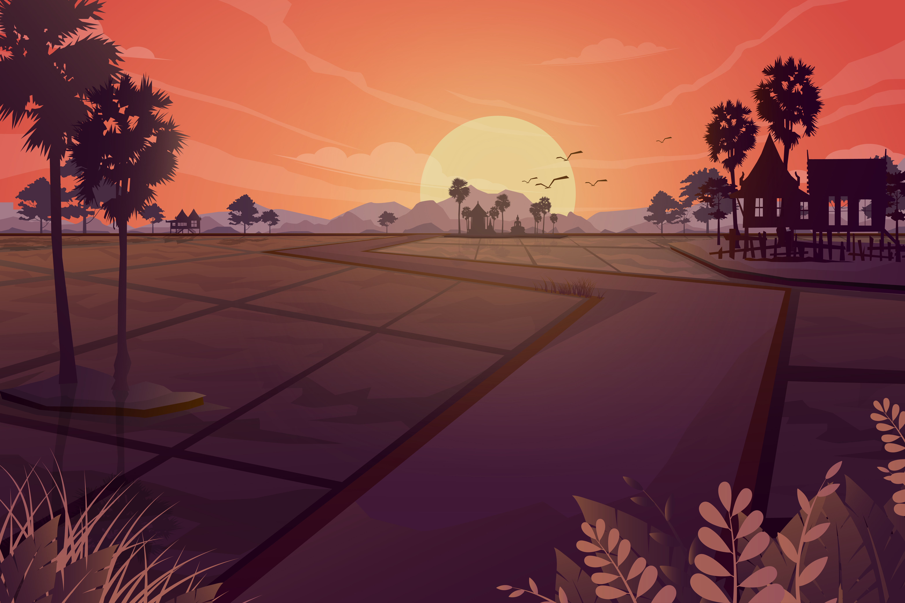
CONTENTS:
Problem Statement Abstract.
Our Ideas & Approach.
Key Components and it’s Coverage.
3a] Sensor integration.
3b] Predictive Analytics Algorithms & Detection Models.
3c] Alerts & Notification of Weather parameters.
3d] Integration of Systems.
4. Integration of ARDUINO IoT Cloud and MATLAB software into a WEBSITE .
5.Distinctive features of our project.
6. How is our Project Different from others? [UNIQUE FEATURES]

Slide 3

Problem Statement Abstract:
The current agricultural landscape faces a critical challenge marked by the inadequacies in traditional irrigation practices, resulting in either excessive water usage, leading to wastage, or insufficient watering, adversely impacting crop health and yield. Furthermore, the deficiency in accurate detection of plant diseases and the judicious application of pesticides exacerbates the issue, as suboptimal knowledge in these areas hinders proactive measures to ensure crop vitality.
This holistic problem demands innovative solutions that integrate precision irrigation methods, advanced disease detection technologies, and optimized pesticide application strategies to promote sustainable and efficient agricultural practices, ultimately enhancing crop productivity and contributing to global food security .
RESOLUTION ?

Slide 4
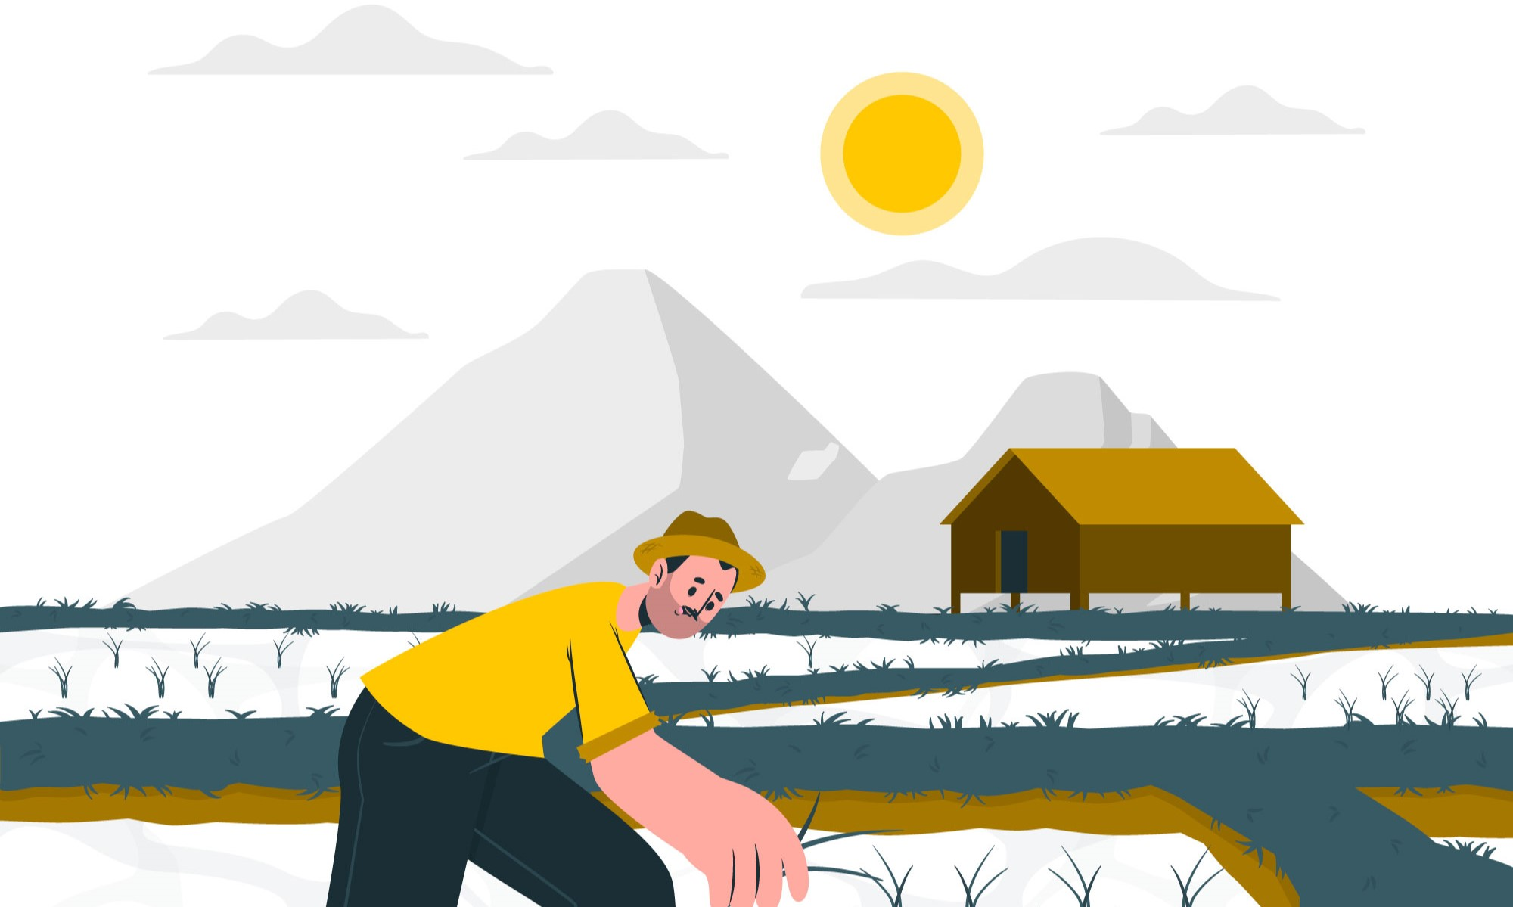
Our Ideas And Approach:
Automated Irrigation System: Empowers users to set moisture thresholds or opt for automated thresholds by choosing a crop in the given options, allowing irrigation for different crops based on distinct moisture thresholds.
Weather data collection: Collaborate with weather APIs or services to integrate real-time weather forecasts into your system. Use this data to predict and adjust irrigation schedules proactively.
Crop Health Imaging: MATLAB image processing and AI algorithms to analyze images to identify plant diseases and pests and automated suggestion of pesticides based on disease diagnosis.
Integration of Sensors: Collect the real time data of parameters such as temperature and moisture using sensors and to display it using dashboards and use it for determining the irrigation schedules.

Slide 5
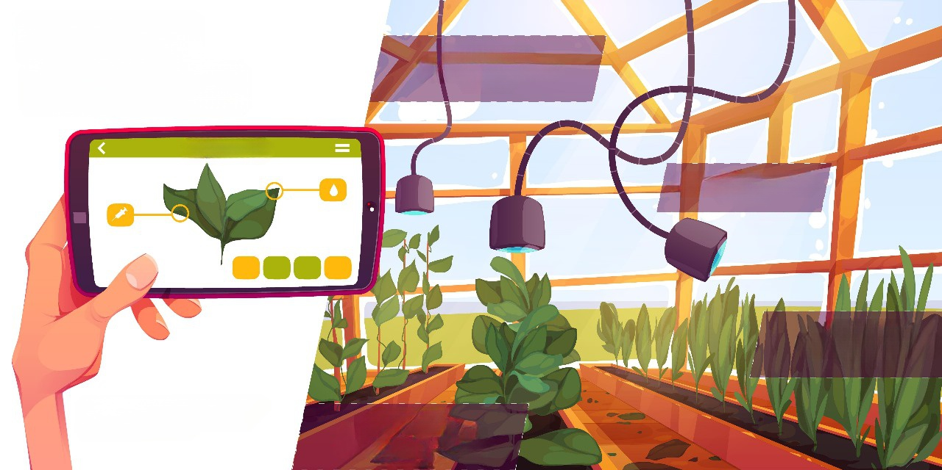
Key Components and its Coverage:
2.Predictive Analytics Algorithms & Detection Models
1.Sensor
Integration.
4.Integration of
Systems.
3.Alerts &
Notifications of Weather
Parameters

Slide 6
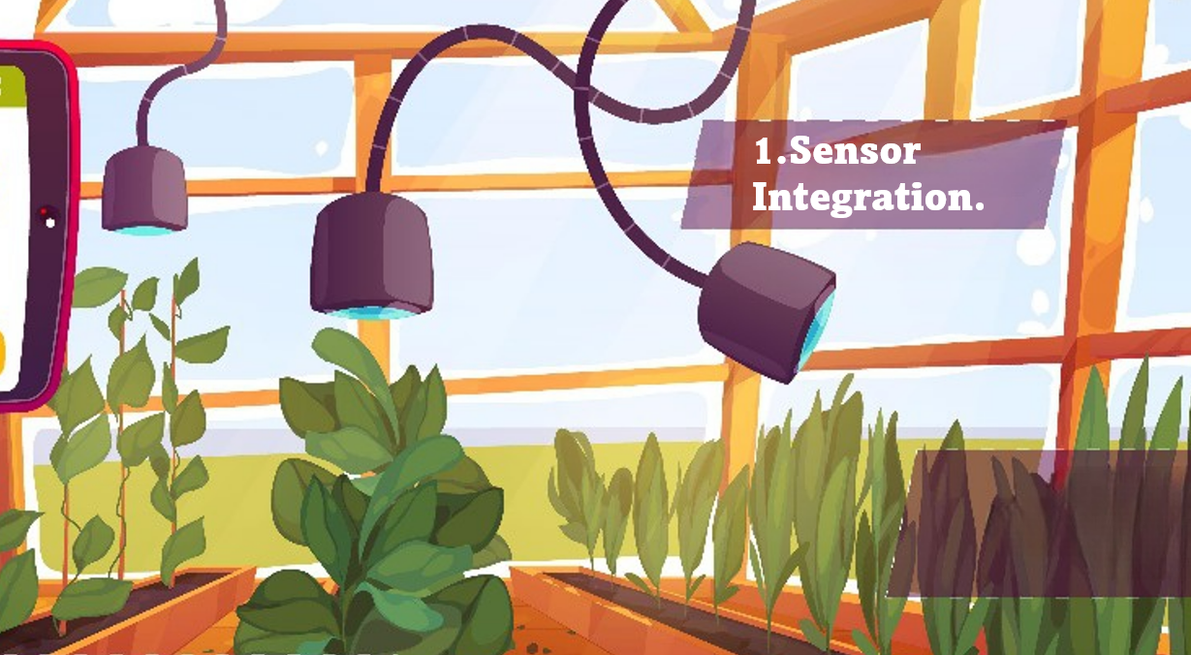
We have used the temperature and moisture Sensors to collect the real time data parameters such as temperature and moisture using sensors and to display it using dashboards and use it for determining the irrigation schedules.
SENSORS USED :
1.Temperature Sensor.
2.Moisture Sensor.

Slide 7
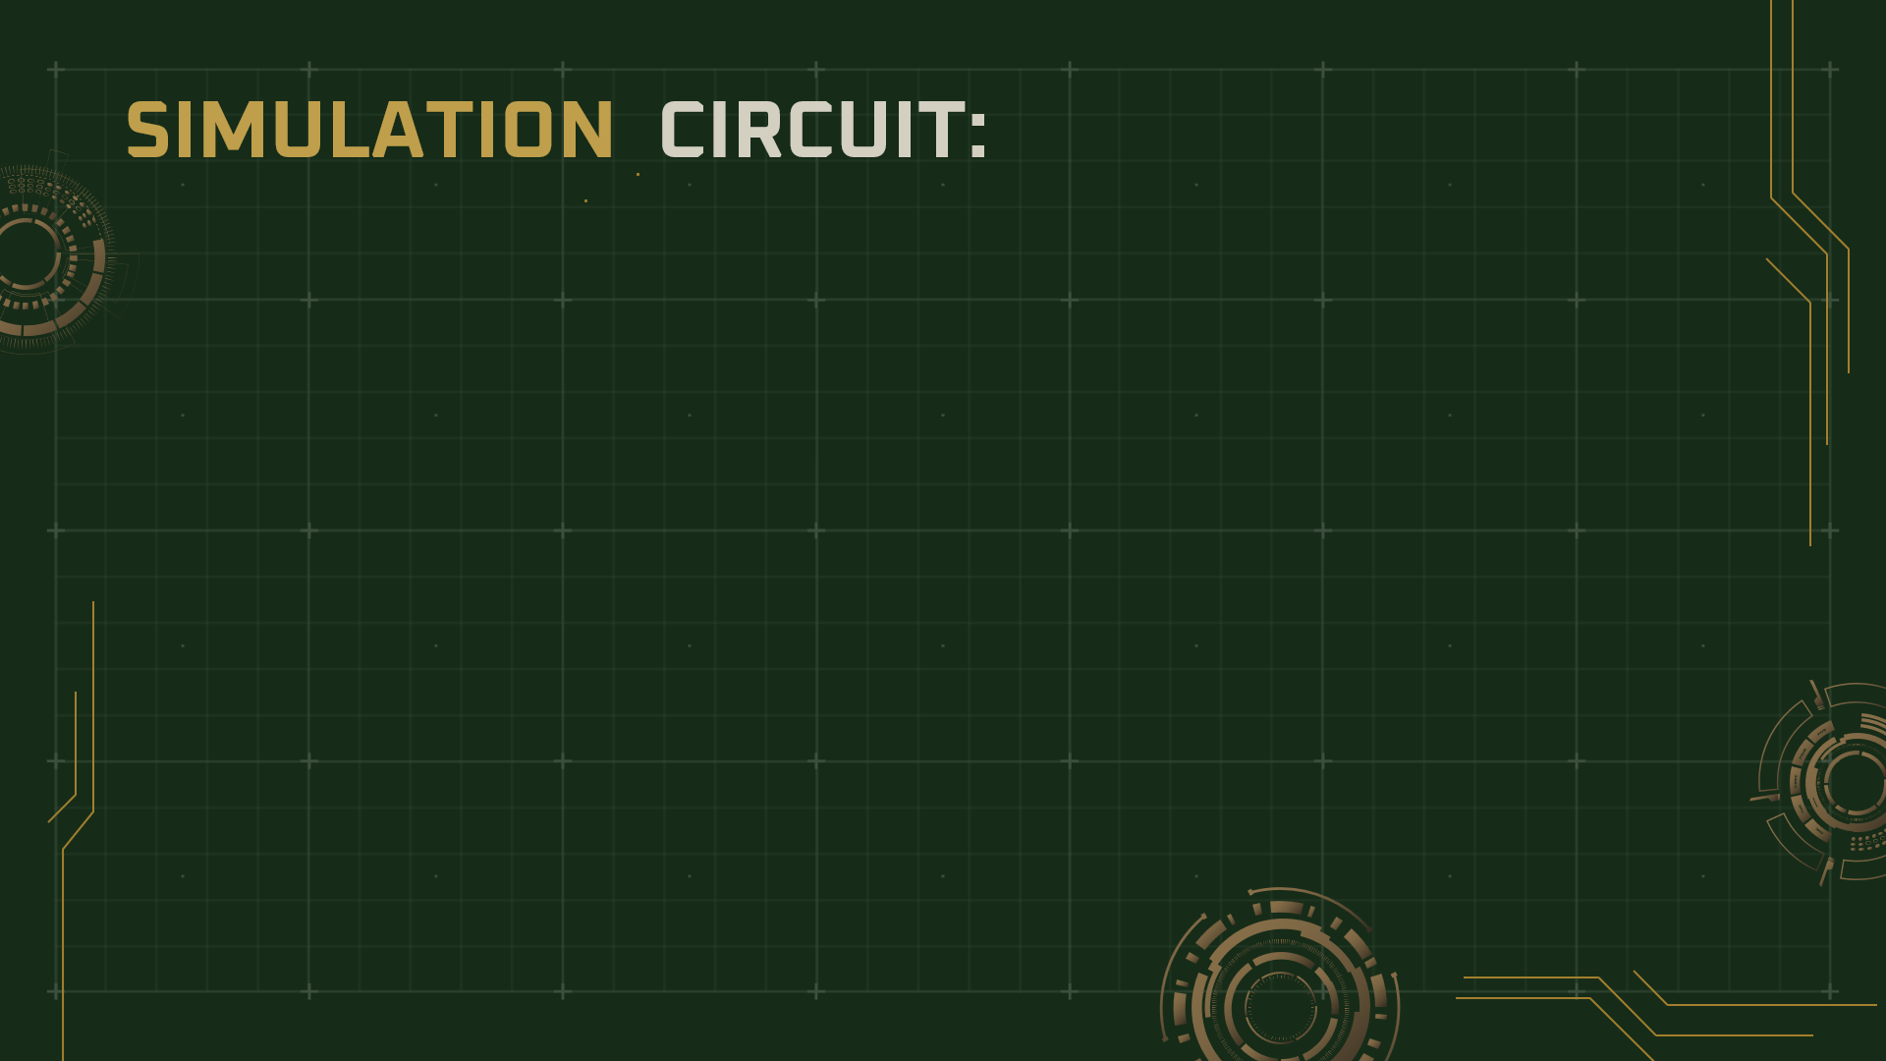
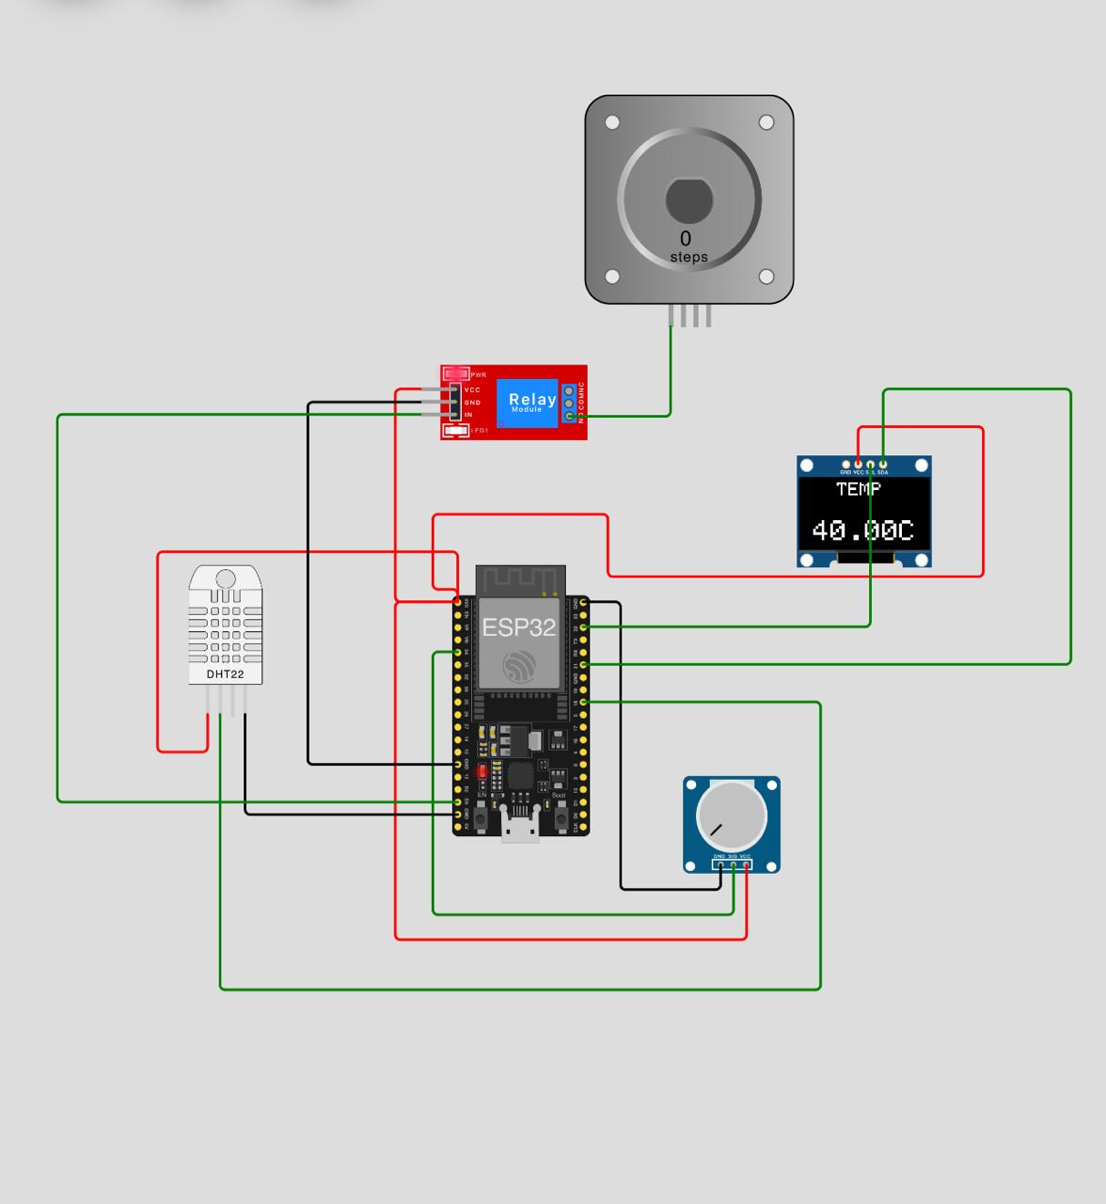

Slide 8
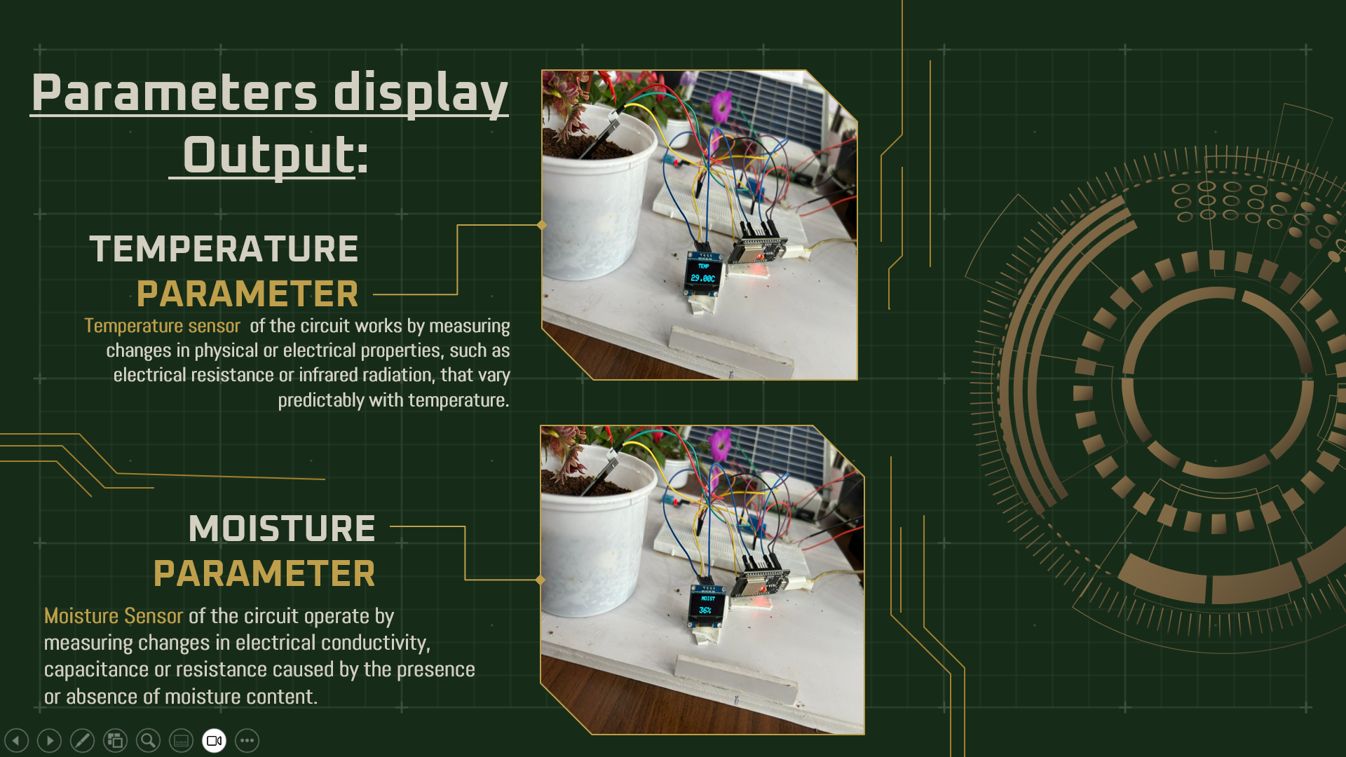

Slide 9
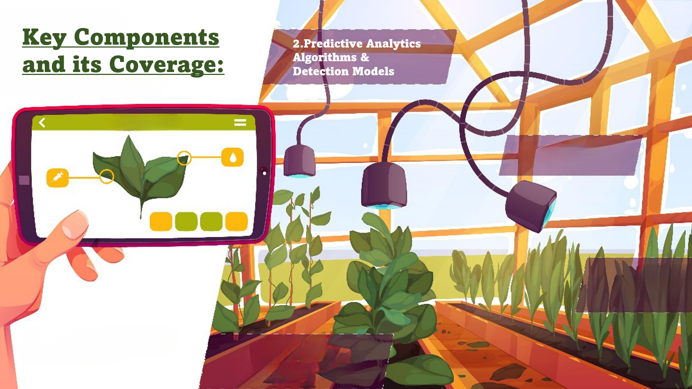
In our project, we utilized Arduino IoT Cloud to establish a comprehensive dashboard , asking input, building live graphs for real-time monitoring and writing codes and algorithms for controlling irrigation practices for(Which can be accessed via both Website and a Mobile App) monitoring moisture, humidity, and temperature levels in a designated environment. The real-time data from Arduino sensors facilitated seamless visualization and analysis of the prevailing environmental conditions.
Simultaneously, we harnessed MATLAB for disease detection through image processing techniques. By leveraging the capabilities of MATLAB, we developed an intelligent system capable of identifying and diagnosing plant diseases based on captured images. This provided an advanced image processing pipeline for the early detection of diseases, enhancing the efficiency of agricultural management practices
Cloud & Software used:
1.ARDUINO IoT Cloud.
2.MATLAB Software

Slide 10
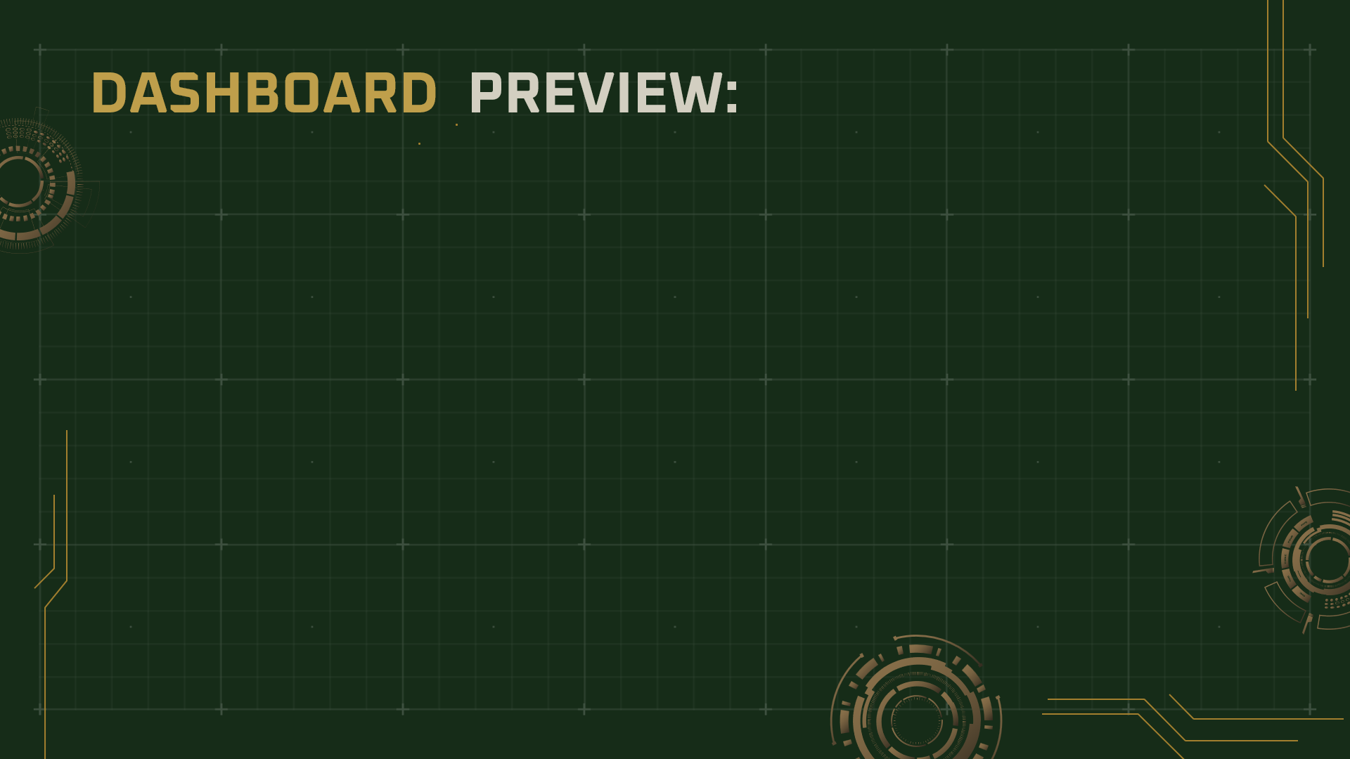
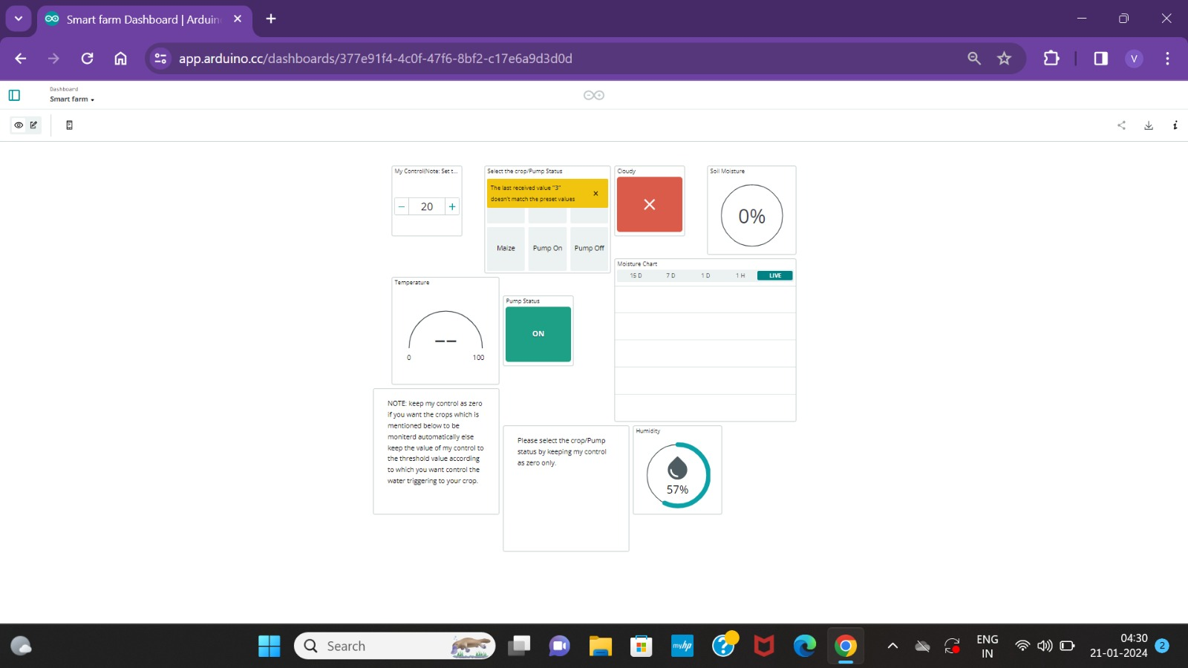

Slide 11
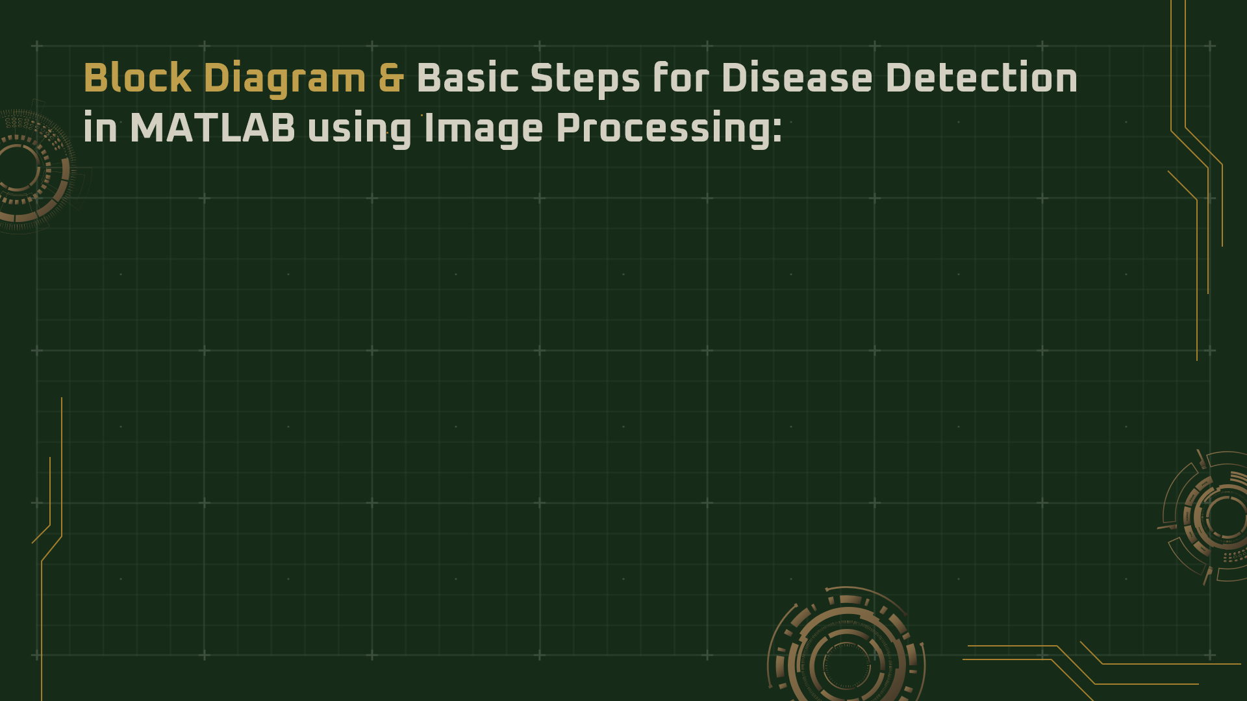
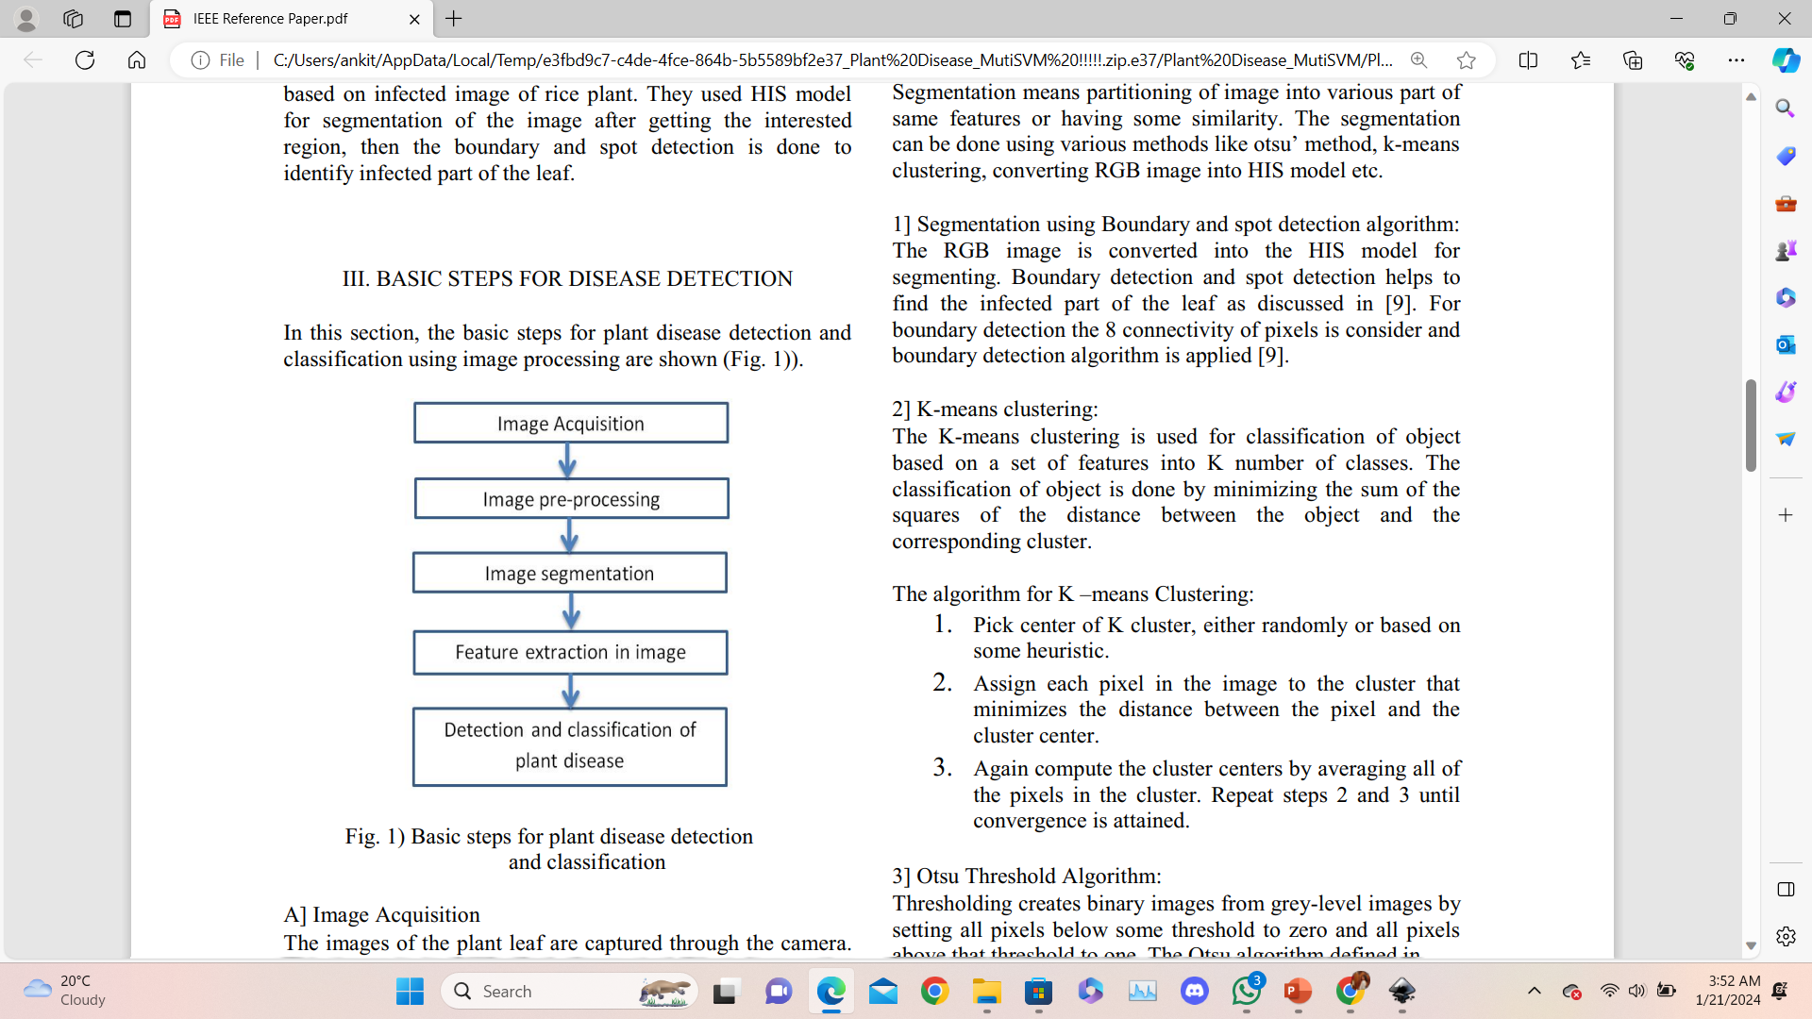
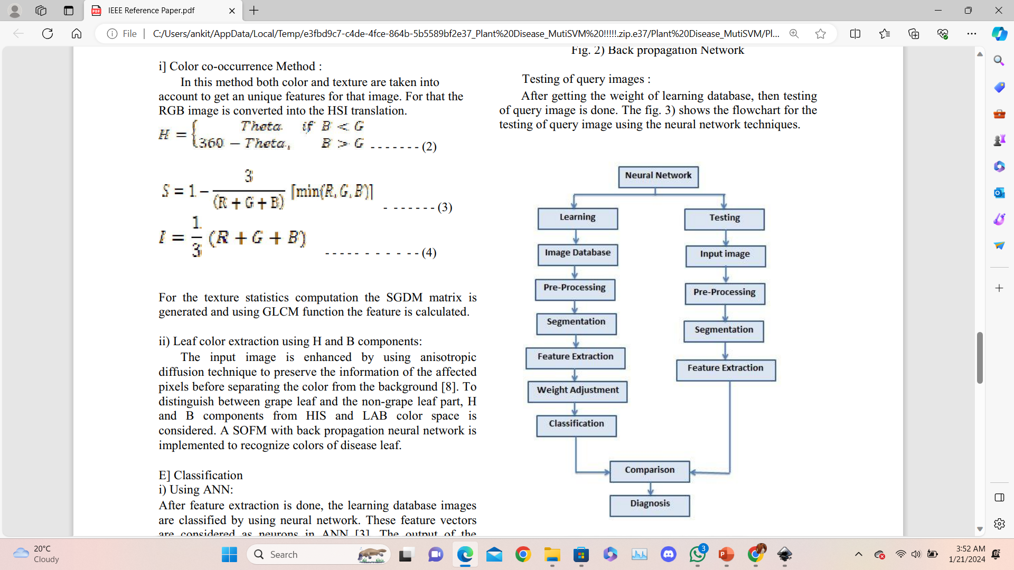

Slide 12
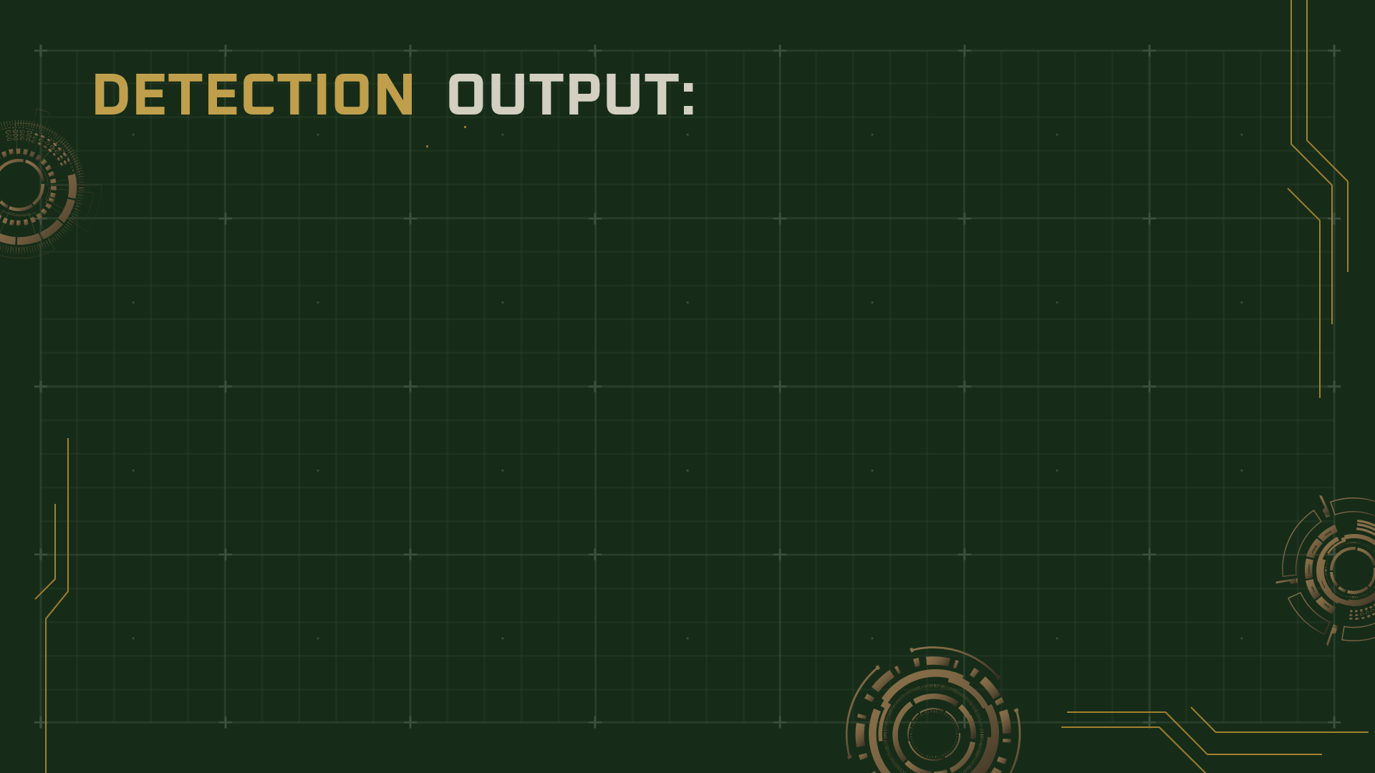
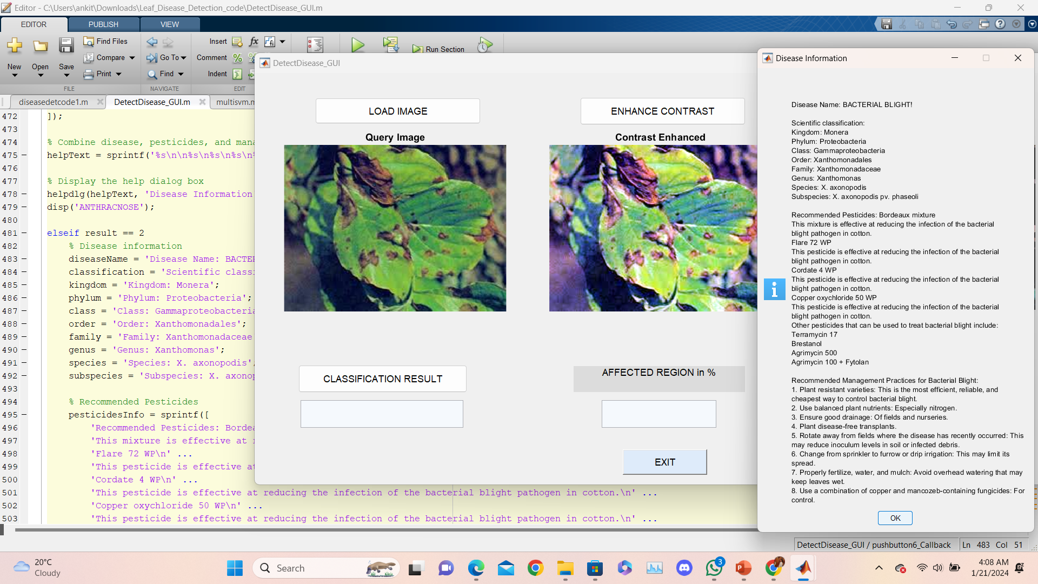

Slide 13
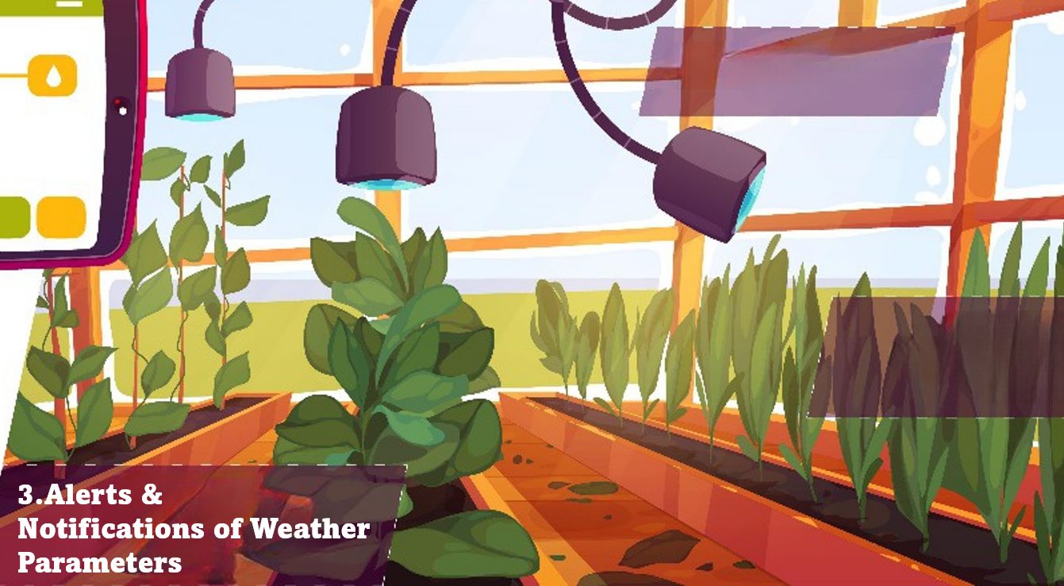
Temperature, Humidity &
Moisture Alerts
In our Arduino IoT setup, we've established Temperature, Humidity, and
Moisture Alerts on the dashboard. Sensors on Arduino continuously track
these parameters, sending real-time data to the IoT Cloud.
Additionally, we’ve integrated OpenWeatherMap, fetching weather details via HTTP
requests in the Arduino code. This dual-notification system ensures users stay
informed about their environment's conditions and broader weather parameters.
Weather Parameter
Notifications

Slide 14
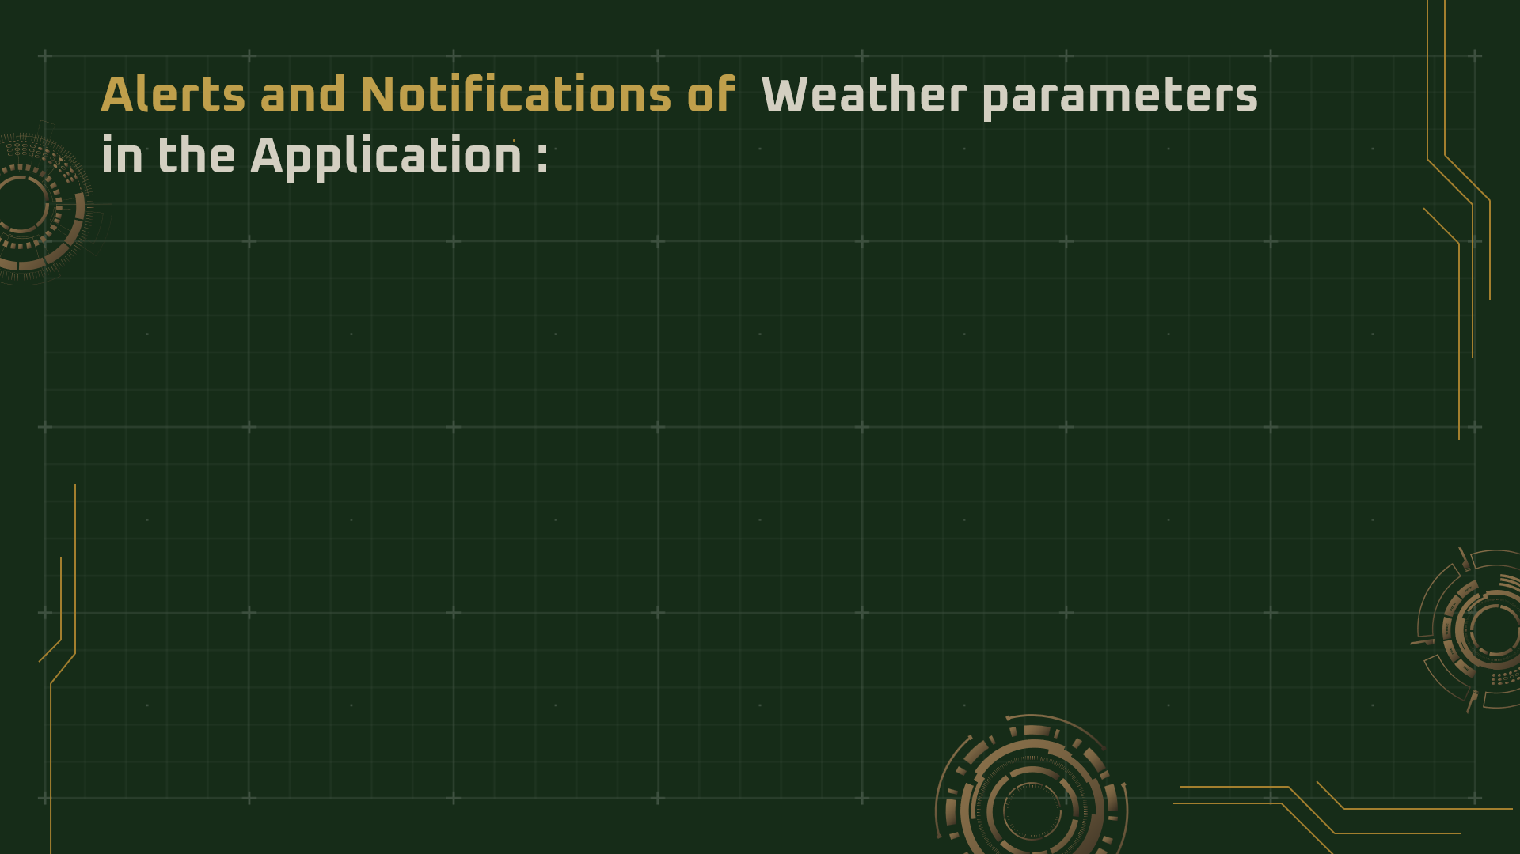
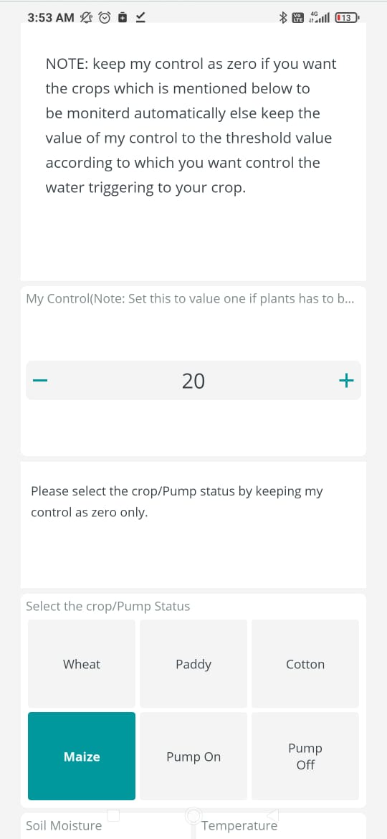
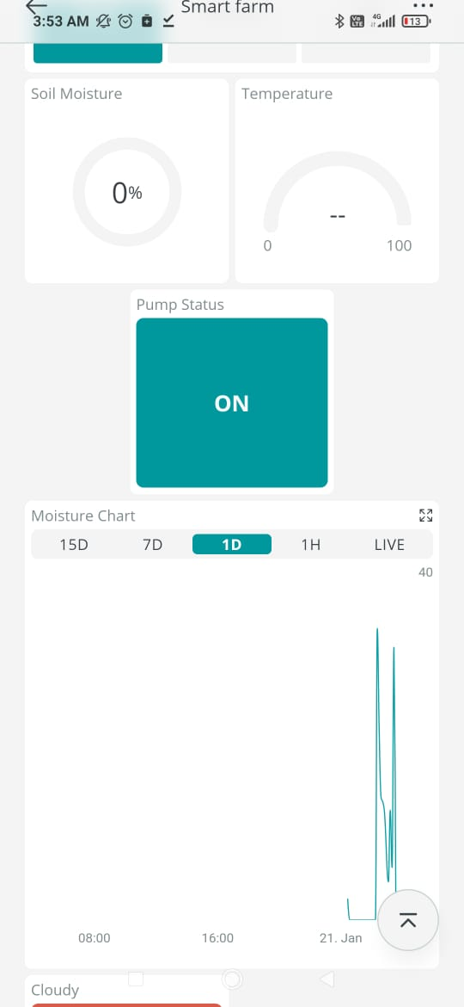
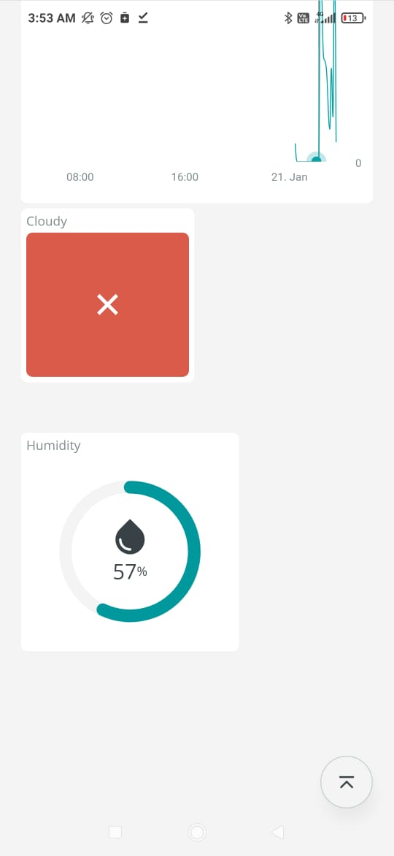

Slide 15

Integration of Arduino IoT Cloud
Software& MATLAB software
in a website
Our project seamlessly combines the functionality of Arduino IoT software, showcasing critical parameters like temperature, humidity, and moisture, with the sophisticated disease detection capabilities of MATLAB. This integrated system is elegantly presented through a dedicated website.
The website serves as a comprehensive platform, providing Farmers with a visually appealing and intuitive interface to monitor and analyze environmental conditions in real-time, thanks to Arduino's sensor data. Simultaneously, the MATLAB-powered disease detection module elevates the platform's utility by offering advanced image processing for timely and accurate identification of potential plant health issues. This amalgamation of cutting-edge technologies not only enhances the user experience but also underscores our commitment to delivering a seamless and sophisticated solution for environmental monitoring and plant health management.

Slide 16
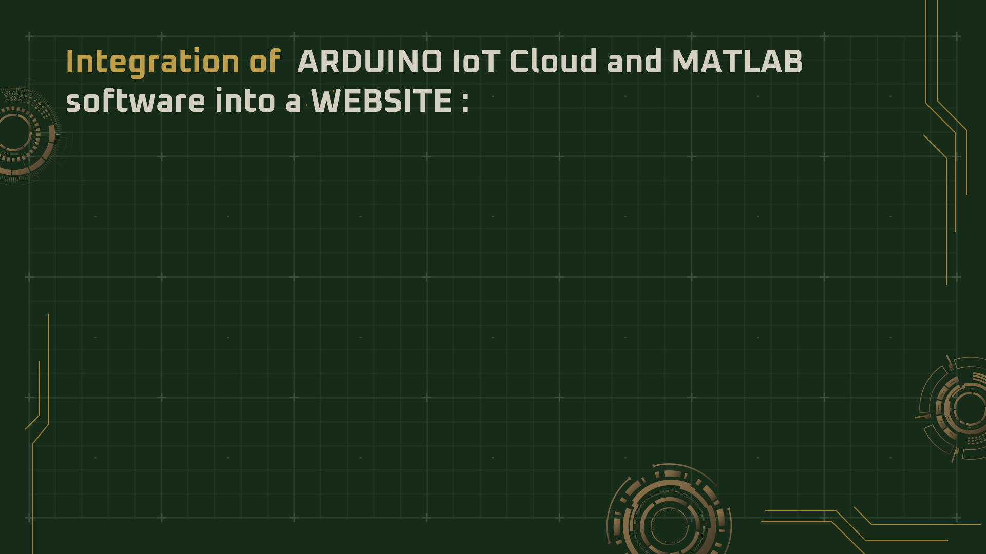
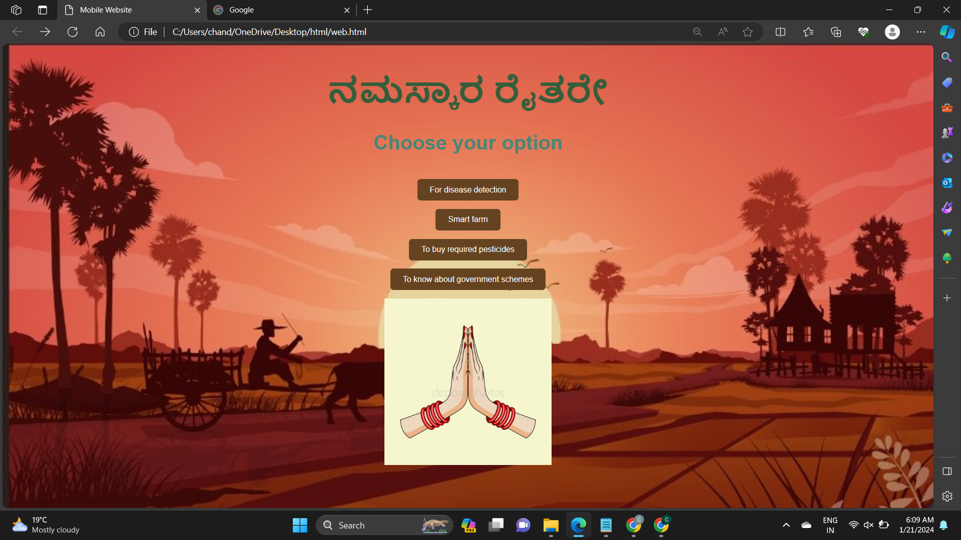

Slide 17
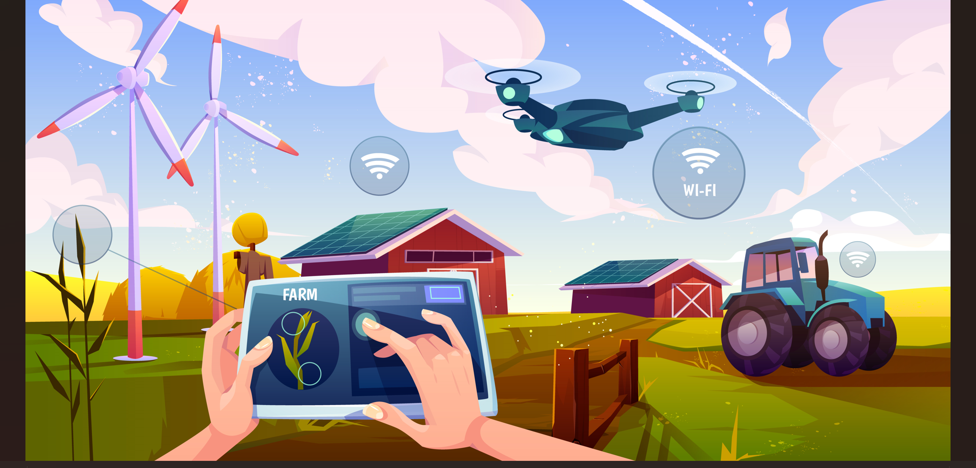
Distinctive Features of our Project:

Slide 18
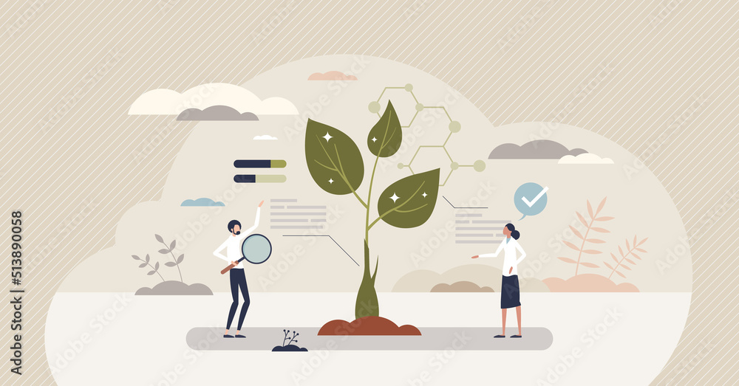
Distinctive Features of our Project:
ESP32 Microcontroller: Integrating sensors and motors for data collection and control.
Arduino IoT Cloud : Building dashboards, asking input, building live graphs for real-time monitoring and writing codes and algorithms for controlling irrigation practices and transferring image to MATLAB for pest and disease analysis.
Open Weather Map: It is used to collect the data on weather conditions and transfer it to Arduino IoT cloud by making an HTTP request in Arduino code.
Wokwi Platform: Simulation for testing.
Disease Detection and Pesticide Recomendation: MATLAB image processing and AI algorithms to analyze images and classify leaves on five categories namely ‘Alternaria Alternata', 'Anthracnose', 'Bacterial Blight', 'Cercospora Leaf Spot' and 'Healthy Leaves’ to diagonose disease and pesticides.
Energy Sustainability Solar panels as an alternative power source for pumps and sensors with automatic switching between solar and battery.

Slide 19
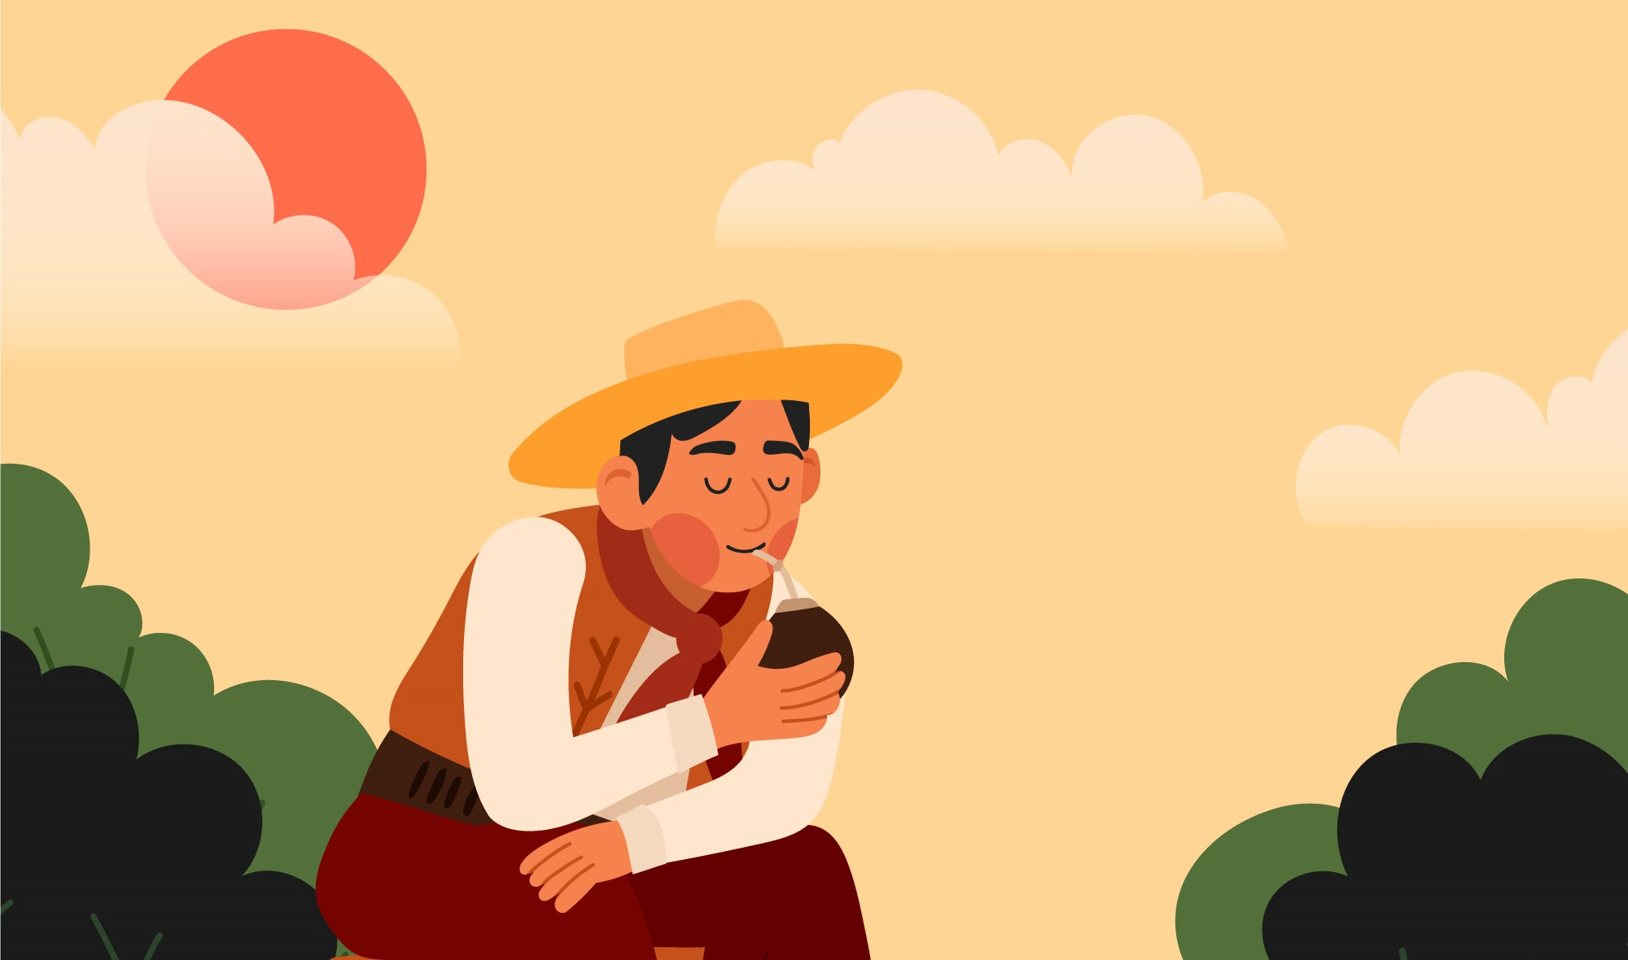
How is our Project
Different from Others?

Slide 20

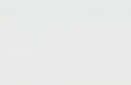
How is our Project Different from Others?
[Unique Features]
1.Choosing MATLAB over Python for disease detection : The disease detection code in python (which is ready made)runs only based one method and is less accurate in providing detection results whereas, the MATLAB code is a more advanced code (and complex to write in general ) provides comparatively accurate output results based on 3 parallelly running codes .
2.Energy sustainability of the project: the project’s energy system self sustainable as it supplied with SOLAR ENERGY via the SOLAR PANELS.

Slide 21
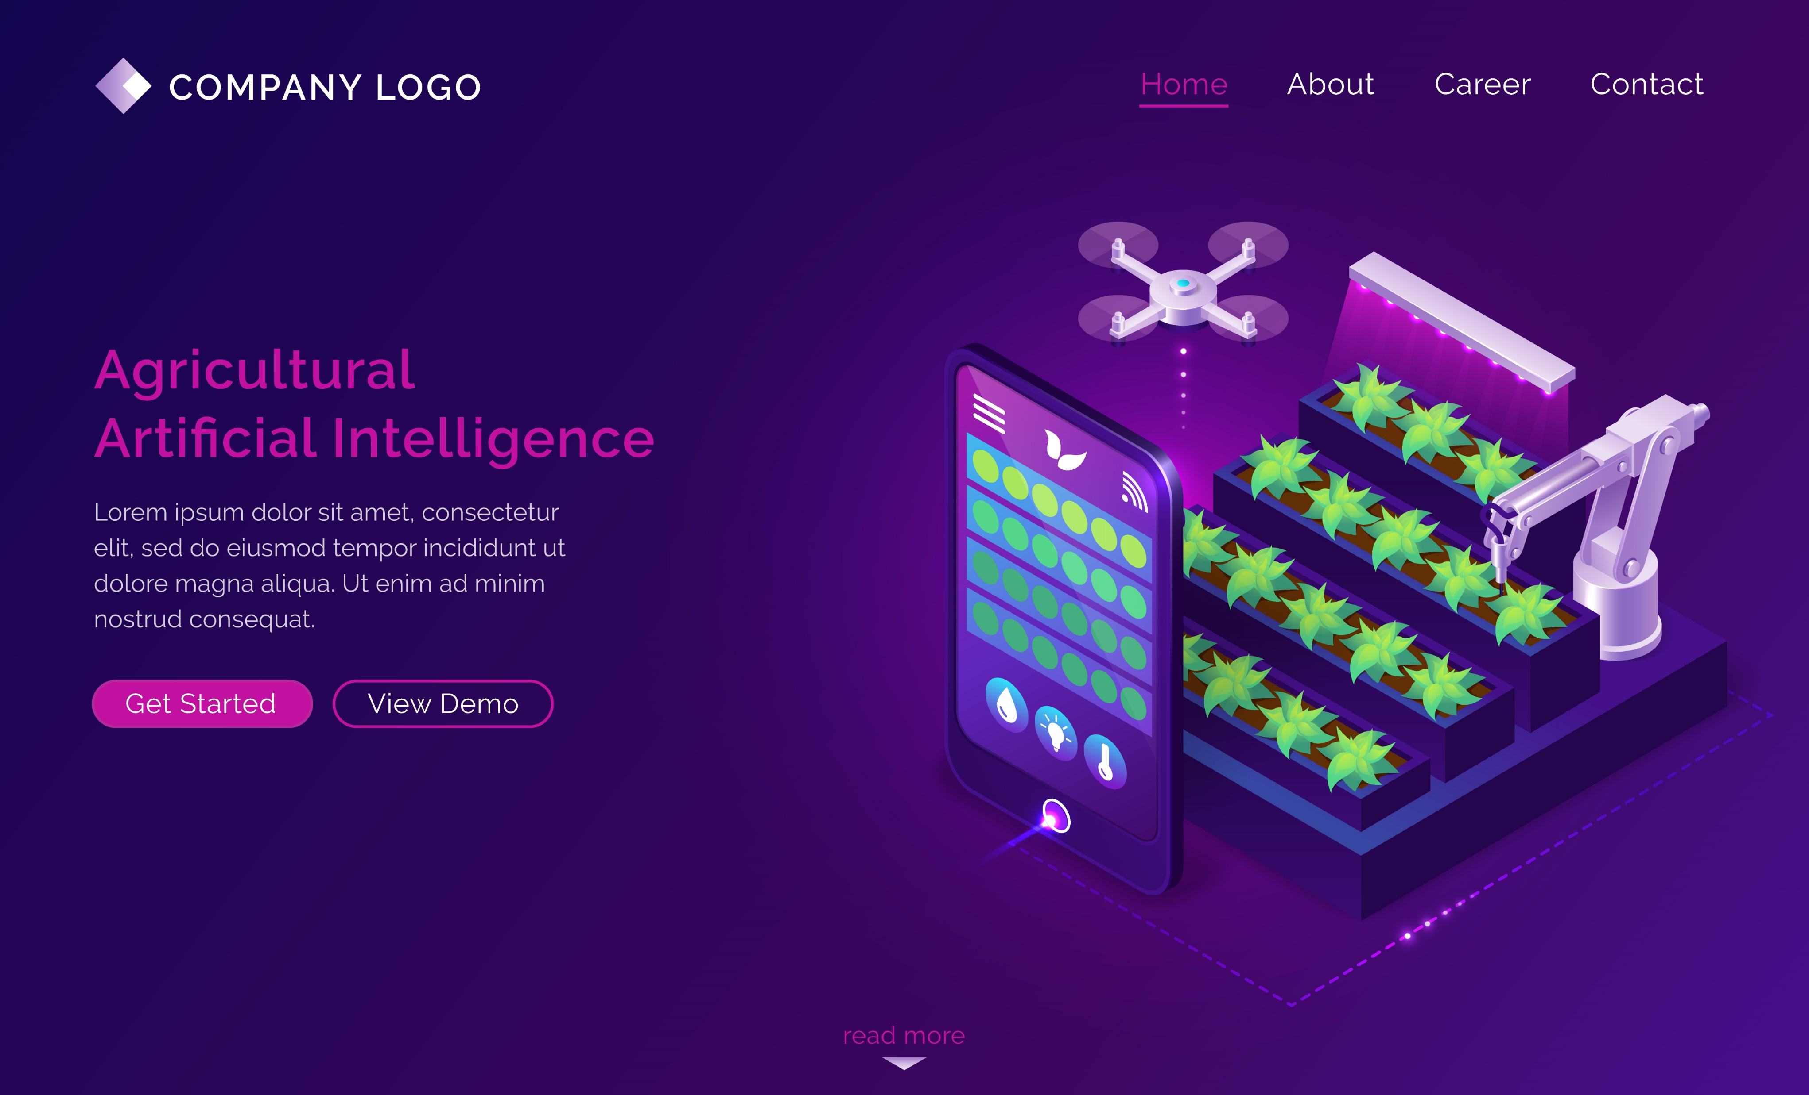

How is our Project Different from Others?
[Unique Features]
3. User-Controlled Irrigation Settings: User can opt for automated thresholds based on selected crops, ensuring precise watering needs as different crops have different moisture thresholds for instance, paddy requires at least 70% moisture whereas maize requires only 50% moisture content. In cases where the desired crop is not listed, users can define their own thresholds.
4. Comprehensive & Recommended Pest Management System: Beyond classification and detecting the particular disease it will also recommend the pesticides to be used for a particular disease.
5. User friendly interface: Various dashboards showing the real time data of parameters such as temperature, moisture and providing live graphs which shows the variation on these parameters over a time and also motor status can be controlled by user in the interface itself.

Slide 22


THANK YOU!

